Slide 1
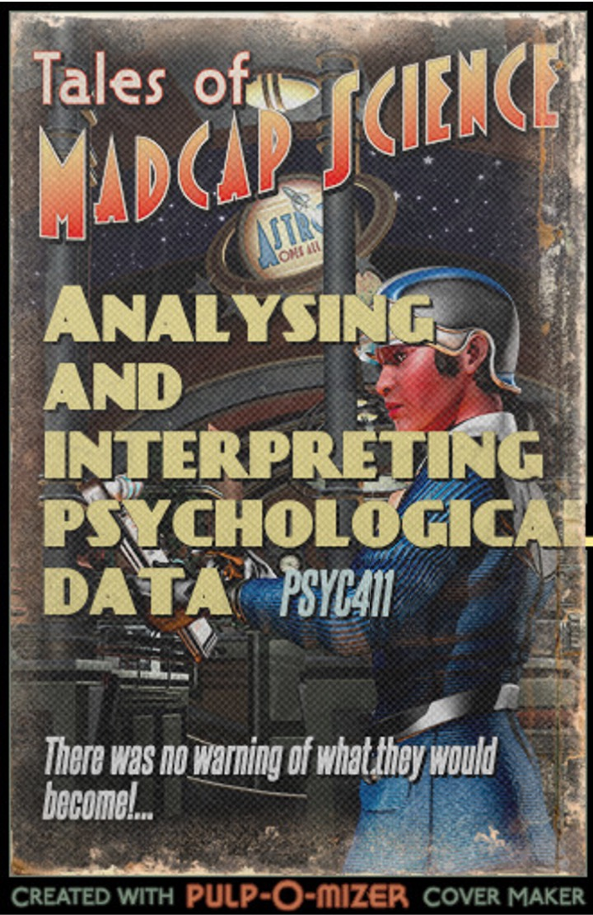
Tales of madcap science

Slide 2
Module outline
Week 1: Introducing data, introducing Rstudio
Week 2: Manipulating data, using Rstudio
Week 3: Exploring data and creating figures and graphs, using Rstudio
Week 4: Categorical data and the chi-squared test – testing random versus structured?
Week 5: t-tests – testing whether two groups are different
Week 6: Research report/analysis
Week 7: Measurement, hypotheses, associations (correlations)
Week 8: Predicting behaviour: the linear model
Week 9: Data visualisation
Week 10: Predicting behaviour: developing the linear model

Slide 3
Objectives for Week 2
By the end of this session, you should be able to:
Understand the importance of open data in psychology
Understand different types of data and how best to represent them
Understand bar graphs, scatter plots, and interpret patterns in these graphs
Open data sets in R-studio and manipulate those data
Use R-studio to make simple graphs

Slide 4

The importance of being open I
Psychology is undergoing a replication crisis
Many famous studies are failing to replicate
Marc Hauser (2010), Harvard
https://www.science.org/news/2014/05/harvard-misconduct-investigation-psychologist-released

Slide 5

The importance of being open II
Psychology is undergoing a replication crisis
Many famous studies are failing to replicate
Diederik Stapel (2011), Tilburg
fabricated and manipulated data for at least 55 publications
https://www.apa.org/science/about/psa/2011/12/diederik-stapel

Slide 6
The importance of being open III
Psychology is undergoing a replication crisis
Fishing expeditions in data collection and analysis
If you conduct 20 tests, or filter, or keep adjusting your data, you change the probability of finding an effect that is not there
Solution is openness: to data, to design, to analysis
In our department: PROSPR (PRomoting Open Science PRactices)
https://www.lancaster.ac.uk/psychology/research/open-science/

Slide 7
The importance of being open IV
Ioannidis (2005) showed that a finding is less likely to be true when:
studies conducted in the field are smaller;
effect sizes are smaller;
there is a greater number and lesser preselection of relationships;
where there is greater flexibility in designs, definitions, outcomes, and analytical modes;
when there is greater financial and other interest and prejudice;
when more teams are involved in a scientific field in pursuit of statistically significant effects
Ioannidis, J. P. A. (2005). Why most published research findings are false. PLoS Medicine, 2(8), e124.

Slide 8
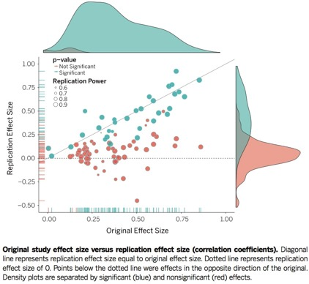
The importance of being open: most findings don’t replicate
Open Science Collaboration (2015). Psychology. Estimating the reproducibility of psychological science. Science, 349(6251), aac4716.

Slide 9
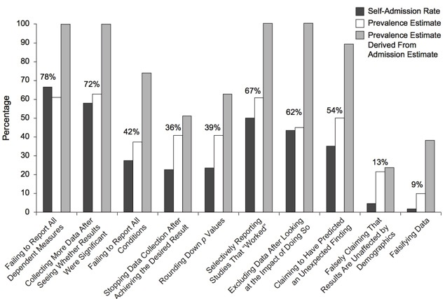
The importance of being open: how did the problems get in there?
John, L., Loewenstein, G., Prelec, D. (2012). Measuring the prevalence of questionable research practices with incentives for truth telling. Psychological Science, 23, 524–532.

Slide 10
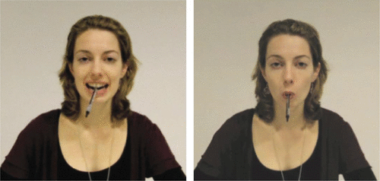
The importance of being replicable: The original
Repeat classic studies to see if they are replicable, using open methods of design, data collection, and analysis
Case study: Strack, F., Martin, L. L., Stepper, S. (1988). Inhibiting and facilitating conditions of the human smile: A nonobtrusive test of the facial feedback hypothesis. Journal of Personality and Social Psychology, 54, 768–777.

Slide 11
The importance of being replicable: The original data
92 participants rated cartoons for funniness, t(89) = 1.85, p = .03
 | Position of Pen
 | Teeth | Hand | Lip
Mean funniness | 5.14 | 4.77 | 4.32

Slide 12
The importance of being replicable: The replication
Wagenmakers, E. J., Beek, T., Dijkhoff, L., Gronau, Q. F., Acosta, A., Adams Jr, R. B., ... & Bulnes, L. C. (2016). Registered Replication Report: Strack, Martin, & Stepper (1988). Perspectives on Psychological Science, 11(6), 917-928.
17 different labs used the same method, testing 1,894 participants
(92 participants in Strack et al.’s original Study 1.)
Notes:
10 point likert scale of liking of cartoons viewed holding pen in teeth or holding pen in lips.

Slide 13
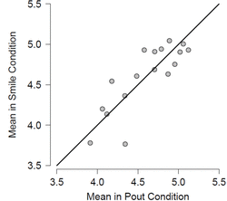
The importance of being replicable: The comparison
Wagenmakers et al. (2016)
Overall effect is 0.03 for smile > pout
But this is not different than chance
The data are openly available
The analyses (using R) are openly available
https://osf.io/pkd65/
The analyses were pre-registered
Fig. 3. The rating for the pout condition is plotted against that of the smile condition across data collected in 17 labs; the facial feedback hypothesis predicts the values to lie above the main diagonal. In Study 1 by SMS, the mean difference was 0.82.
Wagenmakers, E. J., Beek, T., Dijkhoff, L., et al. (2016). Registered replication report: Strack, Martin, & Stepper (1988). Perspectives on Psychological Science, 11(6), 917-928.

Slide 14
Summary
The replicability crisis and open science solutions
Another reason for using R
Importance of making data open and analyses clear in advance

